Slide 1

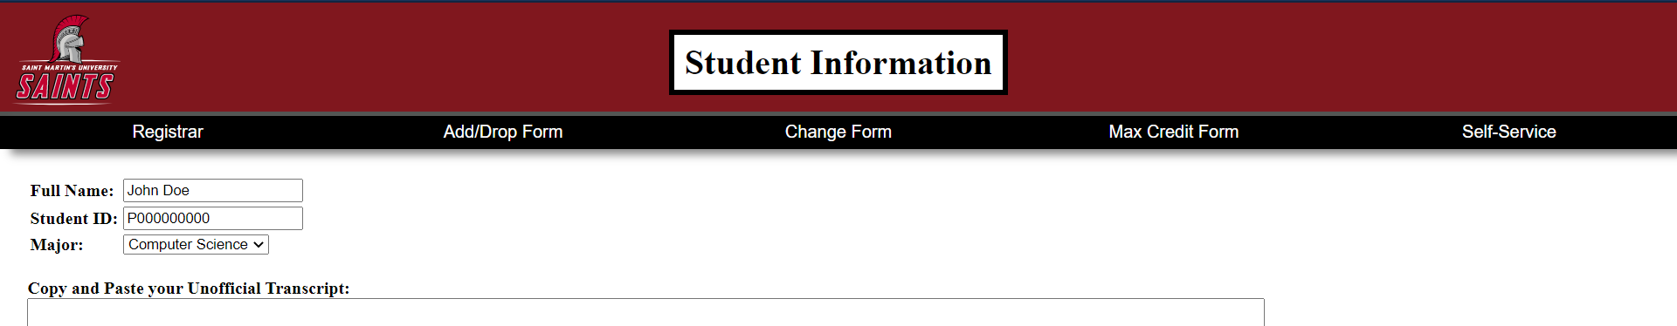
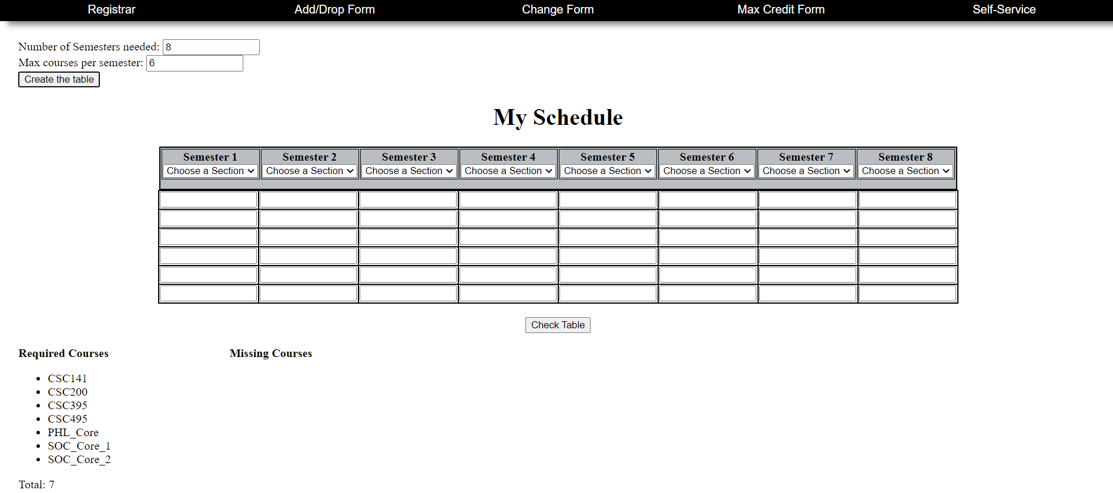
Advisory Assistant
Team Manager: John (Jack) McCarthy
Team Members: Jay Bang, Julia Cutright, and Brendan Tran
Stakeholder: Dr. David Olwell, Dean of The Hal and Inge Marcus School of Engineering
Background
Design Considerations
Budget
During a student’s time at St. Martin’s University, or at other universities across the country, it is not uncommon for students to face troubles when creating a schedule. With ever-changing degree requirements, it can be scary making sure all the credit and course goals are met. Making a schedule that allows students to graduate quickly is vital to most students due to financial concerns too.
Not only is creating a schedule daunting to students, but advisors as well. Advisors are typically assigned to students to help guide them through their degree guidelines. However, with some schools assigning advisors with up to a thousand students, creating unique schedules each student’s needs can be a struggle.
Our group has also discovered that there can be struggles with schedules when students have to change advisors. Each advisor typically has their own methodology when it comes to creating schedules, and when a new advisor takes over, it is possible there can be confusion in understanding the previous advisor’s work. By having one, uniform system that is used by all advisors, this confusion could be eradicated.
Degree Requirements:
In order for students to graduate, there are certain courses they must take depending on their degree. It is important to compare degree requirements with a student’s created schedule to make sure all degree demands are met.
Core Courses:
While the general degree requirements may stay the same for majors, core course requirements may change. This is typically dependent on the year the student is enrolled at St. Martin’s.
Transcript:
As students make progress towards their degrees, it is possible they may change their schedule. When doing so, it is important to look at transcripts to make sure students are passing their courses. This ensures that students do not repeat courses if unnecessary, as well as making sure they retake courses if needed. This would also take into account any AP credits that may count towards degrees.
Course Placement:
Prior to arriving at St. Martin’s, students take tests in English and Mathematics, and occasionally Foreign Language, to determine the student’s proficiency in each subject. If the student scores well, they can be placed in a higher-level course. This allows them to bypass basic core requirements.
Transfer Credits:
When student’s transfer to St. Martin’s, they may have taken courses that are not accepted at St. Martins. By looking at transfer credits, it can be determined what courses the student has credit for, and which they will need to make up.
Prerequisites:
Some more advanced courses may require an introductory course credit prior to enrollment. The student should be notified if such perquisites must be met, so they take the introductory courses earlier, or fill out an override form.
Semester Specific Courses:
Courses may be held only during Fall or Spring semesters. Some classes may even occur once as a special offering.
4+1 Courses:
Certain courses may offer credit towards both a master’s and bachelor’s degree. It is important to consider this so students get credit for both degrees and not just the bachelor’s credit.
Summer Courses:
Summer offerings are typically limited to lower-level courses.
With web-based programs, price can vary greatly. Some services may be offered in package bundles, while other only offer an individual service. As this project is a work in progress, there is currently no specific cost, but we estimate it may be upwards of $2,500 annually to maintain. Below is a list of potential expenditures to consider as the project moves forward.
Web Domain:
The web domain is the webpage, or set of webpages, where the program will exist. The price for a domain can vary greatly depending on the extension, such as .com, .org, and .us. A general price range is $9 to $20 a year, with some domains having an additional, one time purchase cost.
SSL Certificate:
A Secure Sockets Layer (SSL) provides encryption for web-based programs to guarantee better protection of user data. The price range for SSL services can range from $10 to $800 a month, dependent on the size of the webpage.
Website Hosting:
Companies offer to store the files that create websites for a price range of typically $10 to $1000 a month. The cost can vary based on factors such as website traffic, the type of website, bandwidth, and features such as email and SSL.
Maintenance:
Maintaining webpages makes sure they are secure and up to date. The cost of maintenance can range depending on the size and features of the website. A website implementing a database can be much more expensive than a static page. Another aspect that can lead to cost is who performs the maintenance. Work done by a company-backed programmer tends to be more costly than work done by an independent programmer. The cost can accrue hourly or monthly and can range from $35 to $4,000.
Comparable systems that can be purchased cost an upwards of $20,000. By using a final version of our software, it is likely that St. Martin’s will save thousands of dollars each year, which can in turn, possibly lower the cost of tuition for students.
Objectives
Ease the Advising Process
By having a uniform system, students will be able to understand the courses they need to complete their degree. Advisors will also benefit from this program by spending less time looking through degree catalogs and solving how their colleagues do scheduling.
Shorten Time to Earn Degree
With the prices of college leaving many debt for years, students want to complete their degree within four year. By being able to map out a schedule, students and advisors can work together to create a degree path that allows them to complete their requirements in a timely manner, which can save the student thousands of dollars.
Advisory Assistant Interface
Provide Students with Choice
With strict degree requirements, students often feel they have little input on how they would like to have their schedule. This project seeks to highlight where students have elective choices and provides them to take courses in the order they choose, while also taking prerequisites into consideration.
Future Aspirations
With such an expansive scope, the project will be passed to next years class to work on. Features we hope will be implemented later on are course placement, transfer credits, summer courses, prerequisites, and 4+1 courses. The design considerations of most concern and will be a continually updated aspect of the advisory assistant will be the degree requirements, core courses, semester specific courses, and summer courses. As these attributes of scheduling will frequently change it is important to keep these parts updated semesterly.
If possible, it would be beneficial for future teams working on the project to work with the registrar to implement the system within the existing self-service program. This would allow the advisory assistant to be accessed by all students and faculty at St. Martin's to aide in the scheduling process. Self-service would also be able to store security waivers which student would sign when enrolling for courses at St. Martin’s. This would ensure that students are aware of the security risks and will cover FERPA standards that must be met. Implementing self- service may also give the advisory assistant access to databases which store course information. This would save future groups a lot of time, as they would not have to input course data into files to be streamed into the existing program.
Overall, it would be ideal that the advisory assistant be tested by The Hal and Inge Marcus School of Engineering advisors when closer to a final state. This would be to gain feedback and see what additional features may be useful to advisors. After several tests among advisors, advisory assistant will hopefully be used by all advisors at St. Martin’s.
Another possibility would be to allow students to test the program to see if it fits their needs. This would allow students to be able to manipulate their schedule while not meeting with their advisor and maintain a schedule that meets all the degree requirements.
Overall Satisfaction
By having an easy scheduling process, students are likely to be satisfied with the services they receive. Struggles with advising can leave students upset and wanting to transfer. Satisfied students typically leave good reviews and can persuade others in choosing to attend their school.
Team Members
Team Manager: John McCarthy
Jay Bang:
Backend Development (php)
Julia Cutright:
Frontend Development (HTML, CSS, JavaScript)
Research
EAB Presentation
Poster
John McCarthy:
Team Leader
Backend Development (php)
Frontend Development (HMTL, JavaScript)
Conference Proposal
Brendan Tran:
Frontend Development (HTML, CSS)
Conference Proposal

